Slide 1
Modeling the Opioid Epidemic in America
Stone Wang

Slide 2
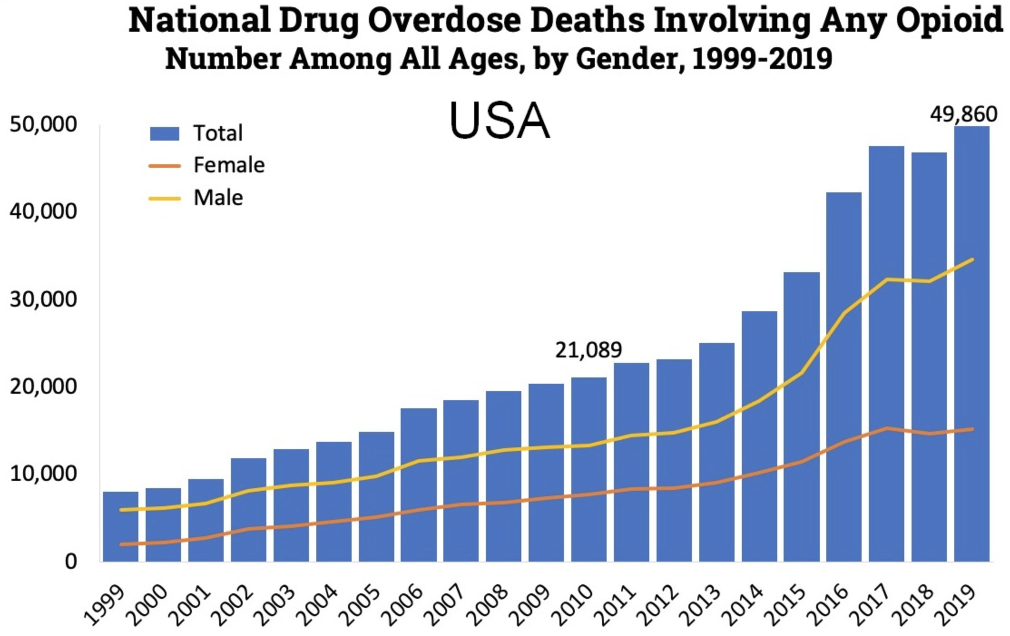
Background
Moderate to strong painkillers including oxycodone, hydrocodone, and fentanyl
More than 70,000 Americans died from any/all drug-involved overdose in 2019
21,088 opioid deaths in 2010, 49,860 opioid deaths in 2019
Rural PA and Philadelphia suffer from highest rate of drug overdose in the country
https://www.drugabuse.gov/drug-topics/trends-statistics/overdose-death-rates

Slide 3
Goal
Discover the demographics impacted the most
Compare Bayesian and frequentist approaches
Explore variable selection methods with interaction terms

Slide 4
CDC Wonder Data
Online database with ad-hoc query system for analysis of public health data
Data range from 1999 to 2018
Can only export 5 factors:
Gender: Male, Female
Race: American Indian/Alaska Native, Asian, African, White
Age group: 5-year groups from 20 to 64
Deaths
Population
Response: crude rate (mortality rate) = Deaths/Population
Year | Gender | Race | Age | Deaths | Population | Crude Rate | CR.100
2005 | M | White | 55-59 | 369 | 7233416 | 5.10E-05 | 5.10132
2005 | F | White | 60-64 | 74 | 5812425 | 1.27E-05 | 1.27313
2005 | M | White | 60-64 | 136 | 5418172 | 2.51E-05 | 2.51007
2006 | F | American Indian or Alaska Native | 20-24 | 1 | 154010 | 6.49E-06 | 0.64931
2006 | M | American Indian or Alaska Native | 20-24 | 8 | 171339 | 4.67E-05 | 4.66911

Slide 5
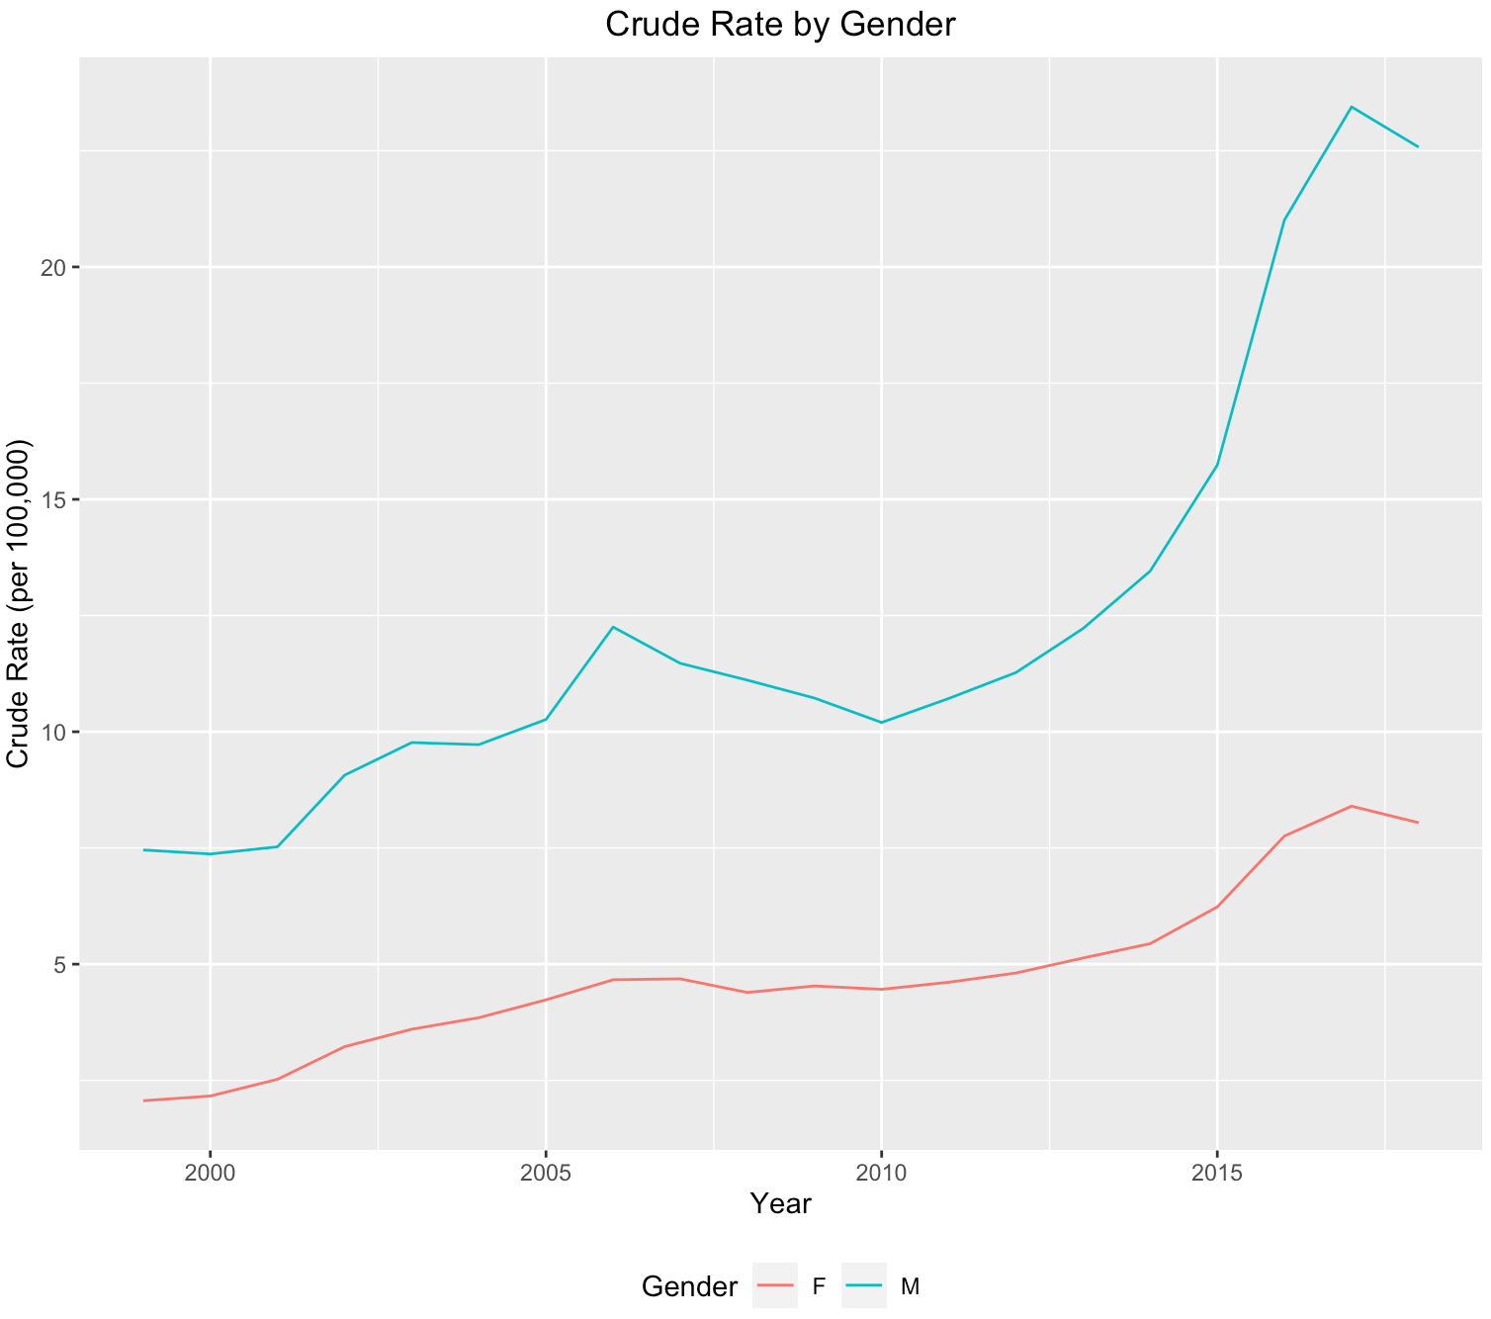
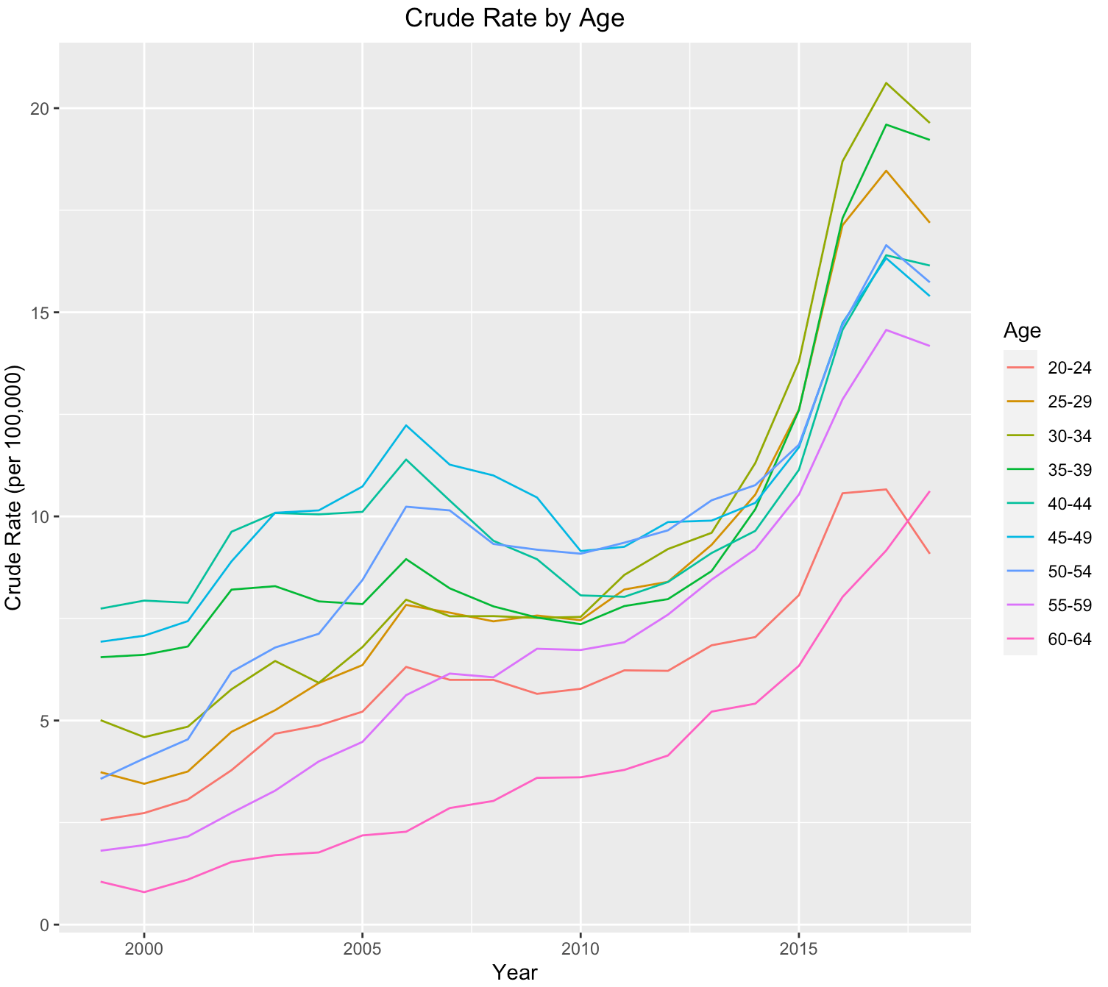
EDA

Slide 6
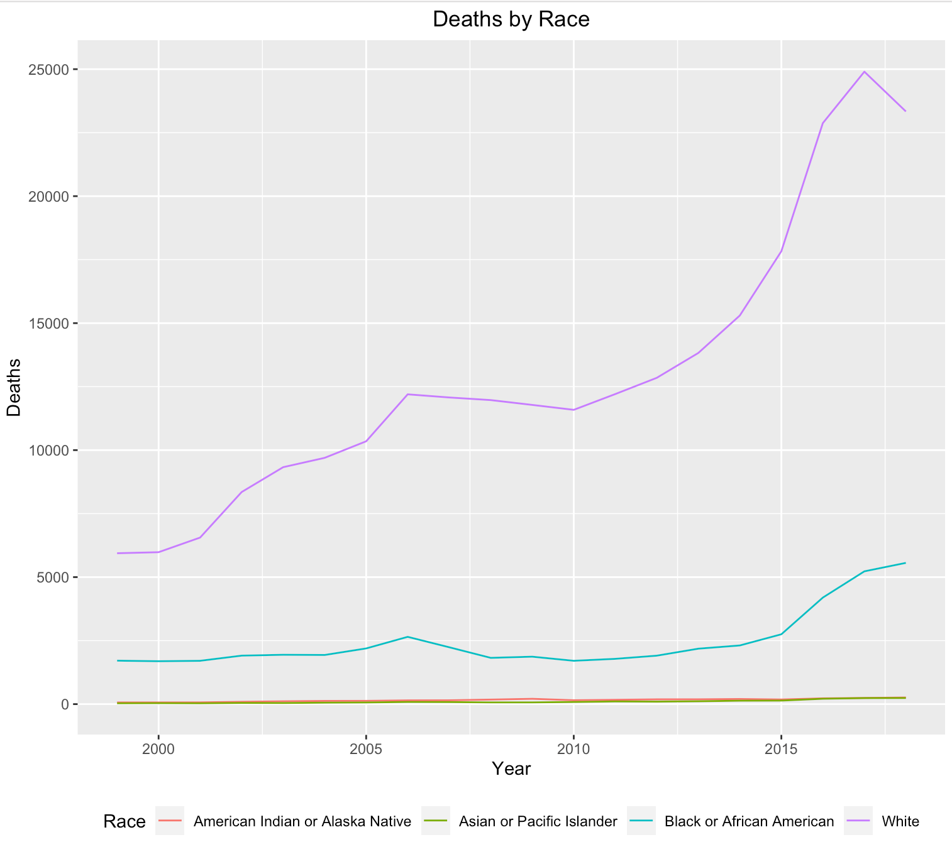
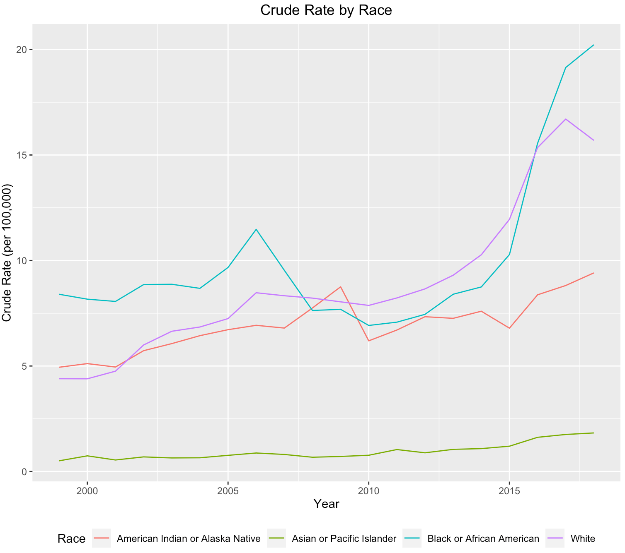
EDA

Slide 7
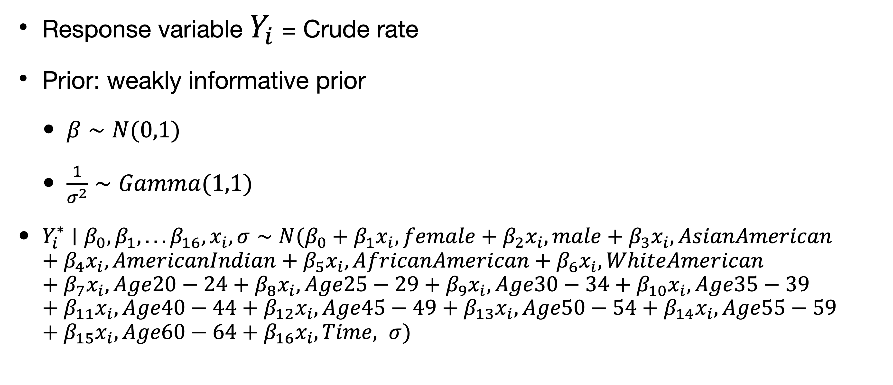
Bayesian Linear Regression
Response variable $Y_{i}$ = Crude rate
Prior: weakly informative prior
$β∼N(0,1)$
$\frac{1}{σ^{2}}∼Gamma(1,1)$
$Y_{i}^{∗}∣β_{0},β_{1},...β_{16},x_{i},σ∼N(β_{0}+β_{1}x_{i},female+β_{2}x_{i},male+β_{3}x_{i},AsianAmerican+β_{4}x_{i},AmericanIndian+β_{5}x_{i},AfricanAmerican+β_{6}x_{i},WhiteAmerican+β_{7}x_{i},Age20−24+β_{8}x_{i},Age25−29+β_{9}x_{i},Age30−34+β_{10}x_{i},Age35−39+β_{11}x_{i},Age40−44+β_{12}x_{i},Age45−49+β_{13}x_{i},Age50−54+β_{14}x_{i},Age55−59+β_{15}x_{i},Age60−64+β_{16}x_{i},Time, σ)$

Slide 8
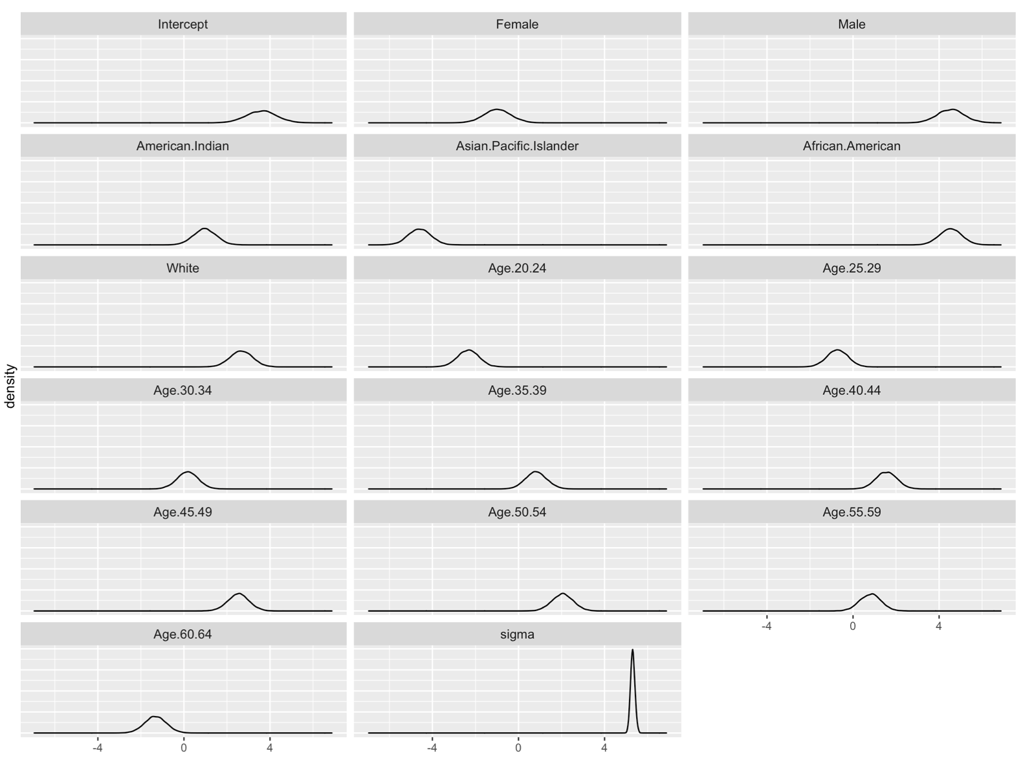
Posterior distribution for variables

Slide 9
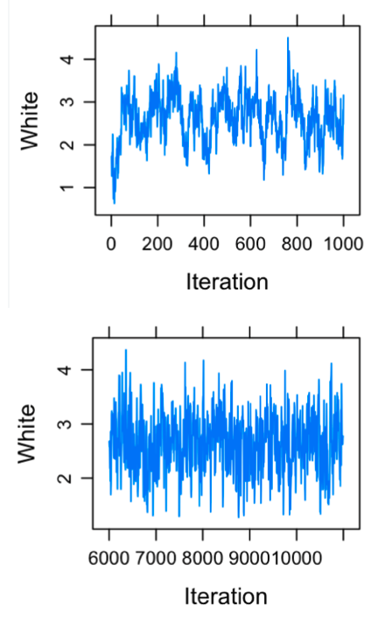
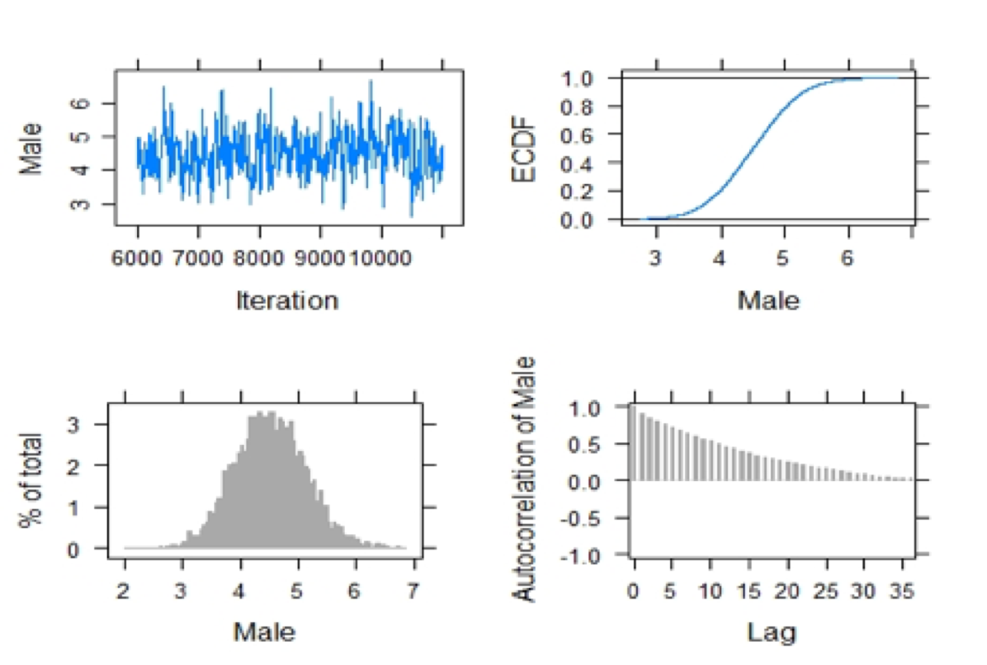
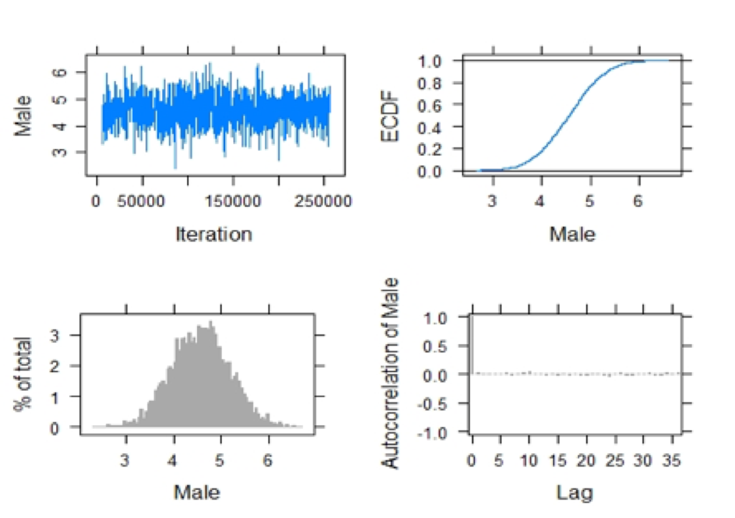
Diagnostics
Before (left) and after (right) thinning in MCMC sampling
MCMC convergence: Traceplot of MCMC sampler for White
covariate; bottom is burn-in of 5,000 samples

Slide 10
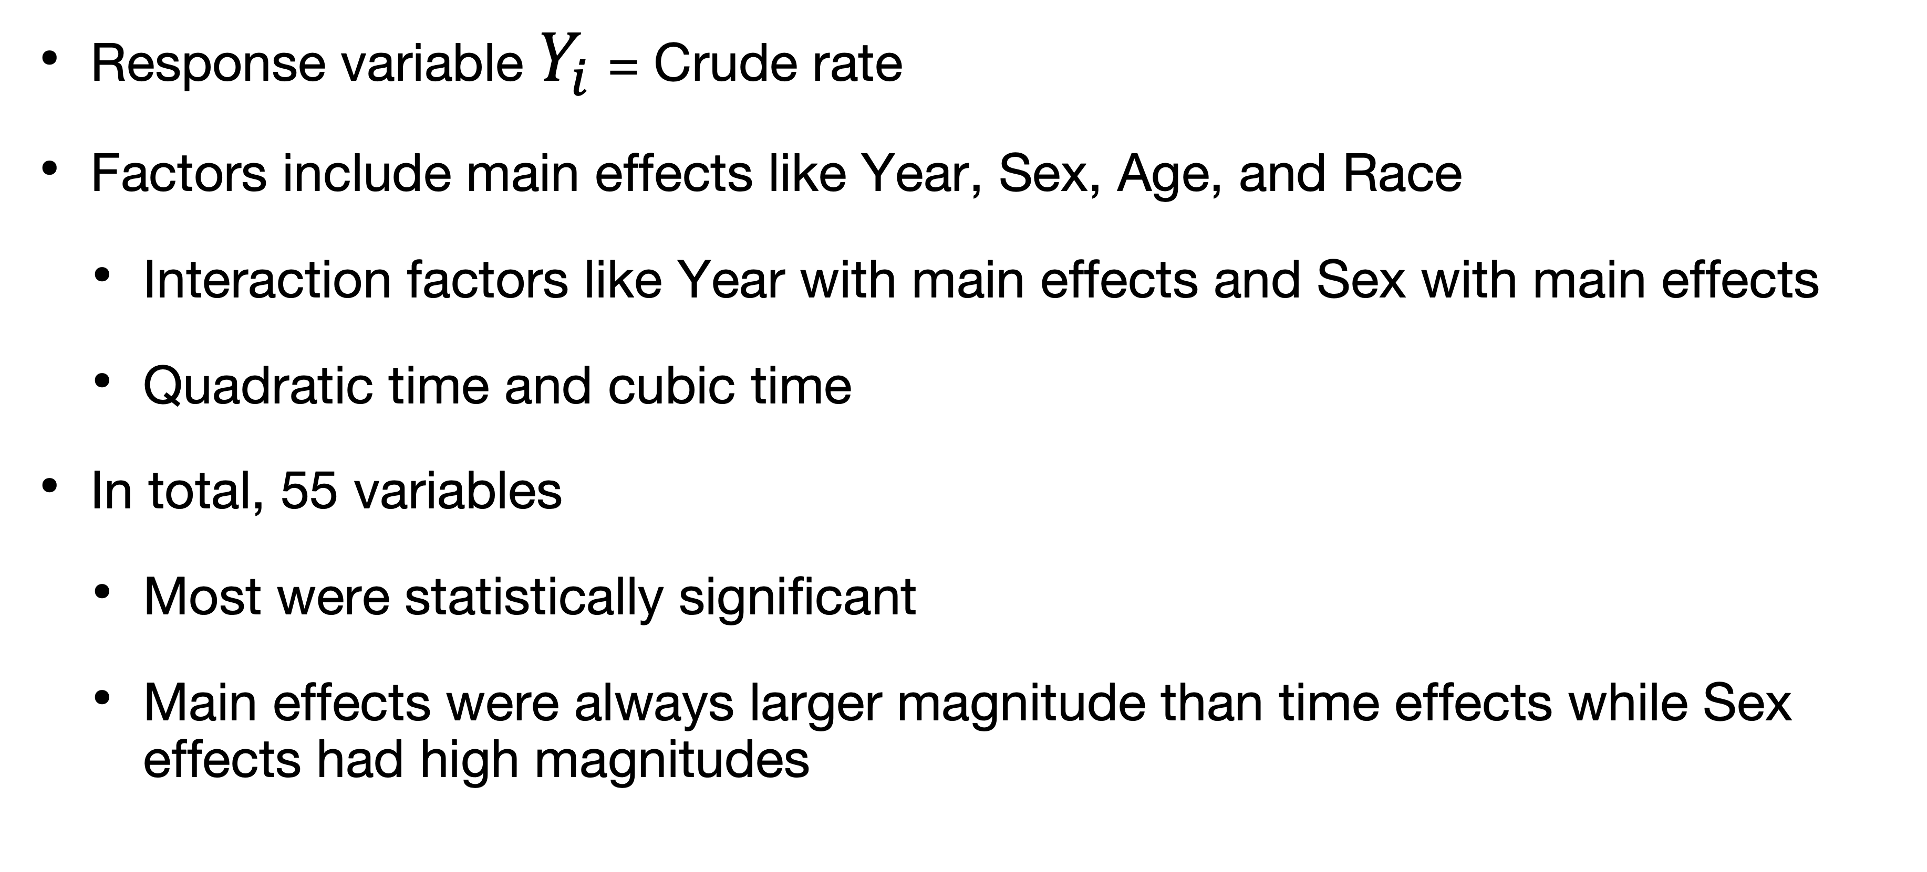
Multiple Linear Regression
Response variable $Y_{i}$ = Crude rate
Factors include main effects like Year, Sex, Age, and Race
Interaction factors like Year with main effects and Sex with main effects
Quadratic time and cubic time
In total, 55 variables
Most were statistically significant
Main effects were always larger magnitude than time effects while Sex effects had high magnitudes

Slide 11
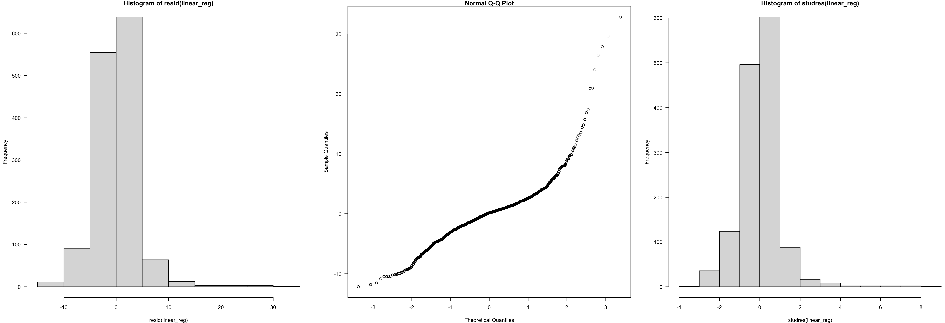
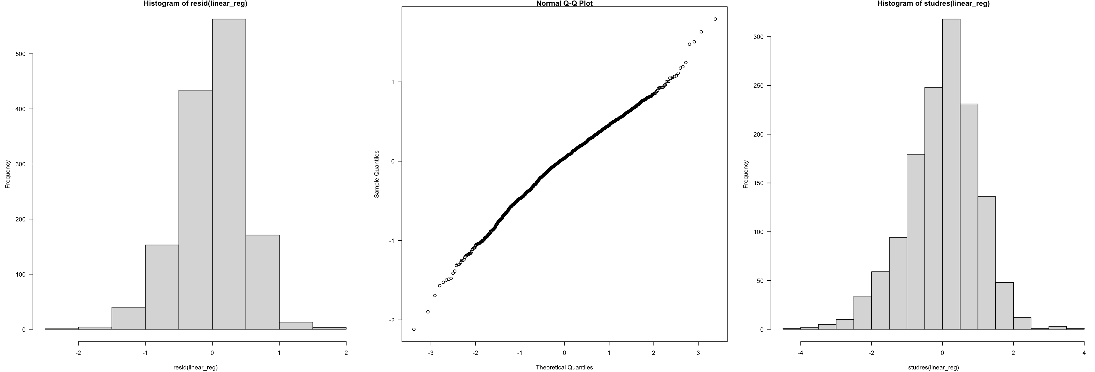
Regression diagnostics
Pre-transformation
9 observations above 4
Post-transformation
0 observations above 4
Notes:
Pre: Rsq 0.68 BIC 8000
Post: Rsq 0.85 BIC 2200

Slide 12
Choosing the Best Model
Bayesian model selection using Bayesian information criterion (BIC)
If model with lowest BIC is picked, may be ignoring the presence of other models that are equally good or can provide useful information
CI may be narrower since uncertainty is being ignored when considering only one model
Bayesian Model Averaging: BMA
Uses the posterior probability of each model
Weighted averages of quantities of interest using these probabilities as weights (higher post. prob = higher weight)
Stepwise selection with R squared, BIC, AIC
LASSO penalization for variable selection

Slide 13
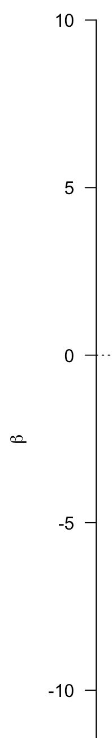
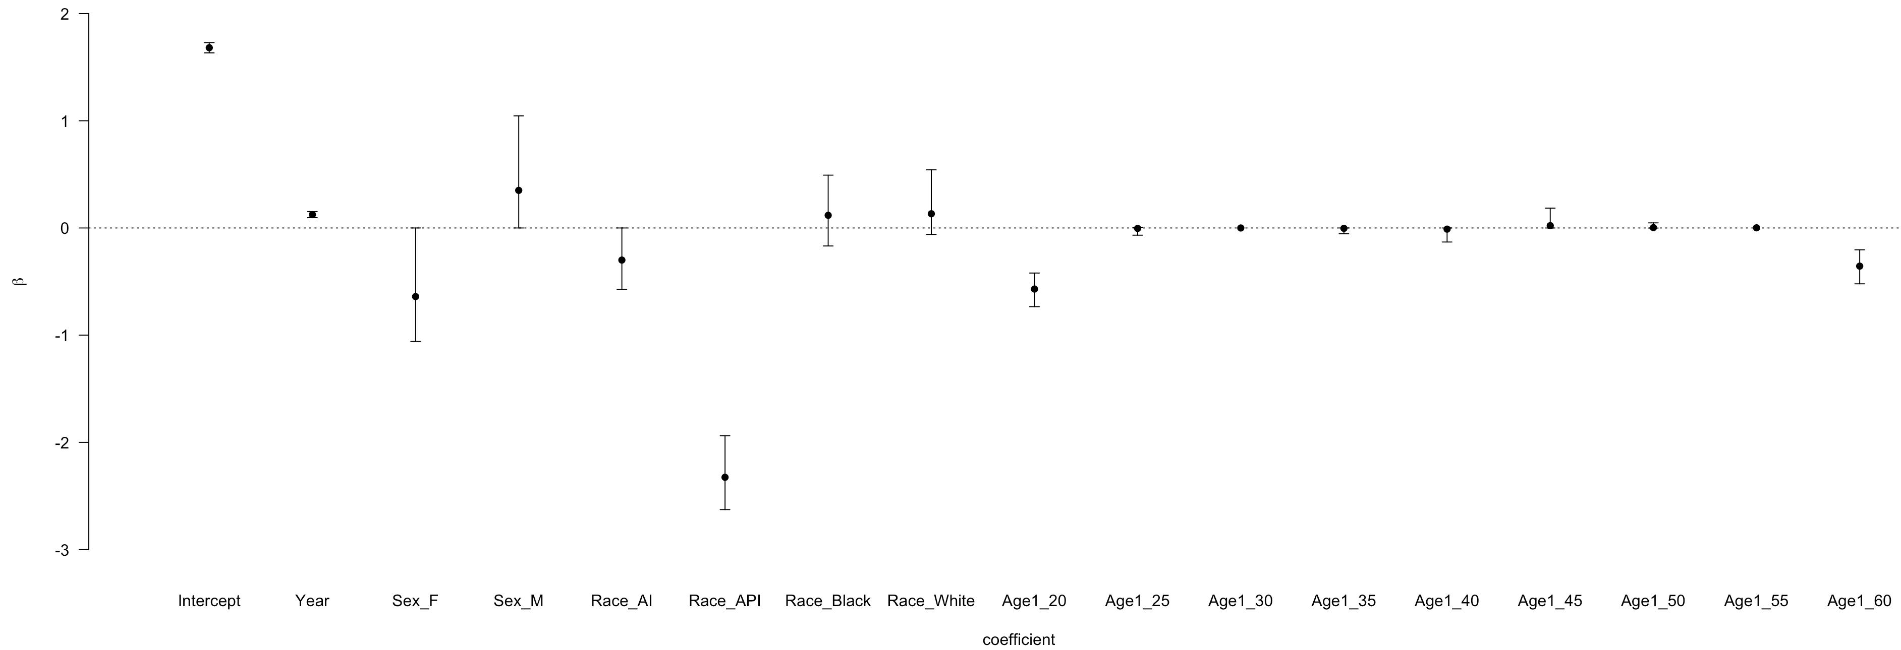
Bayesian Model Averaging
Modeling Averaging: Year, Male, Asian, American Indian, Black, White, 20-24, 50-54, and 55-59

Slide 14
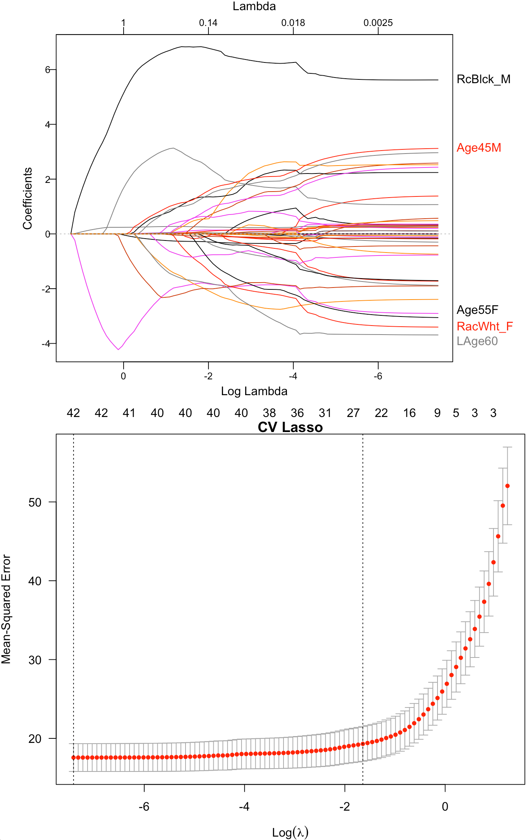
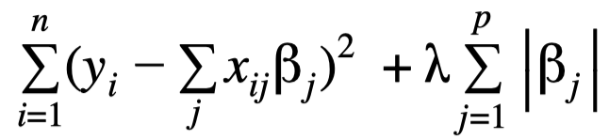
LASSO Penalized Regression
Lambda 1SE vs lambda Min
-1.64 vs -7.41
26 variables vs 43 variables
Adjusted R-squared
R² = 0.842 for 43 variables
R² = 0.823 for 26 variables

Slide 15
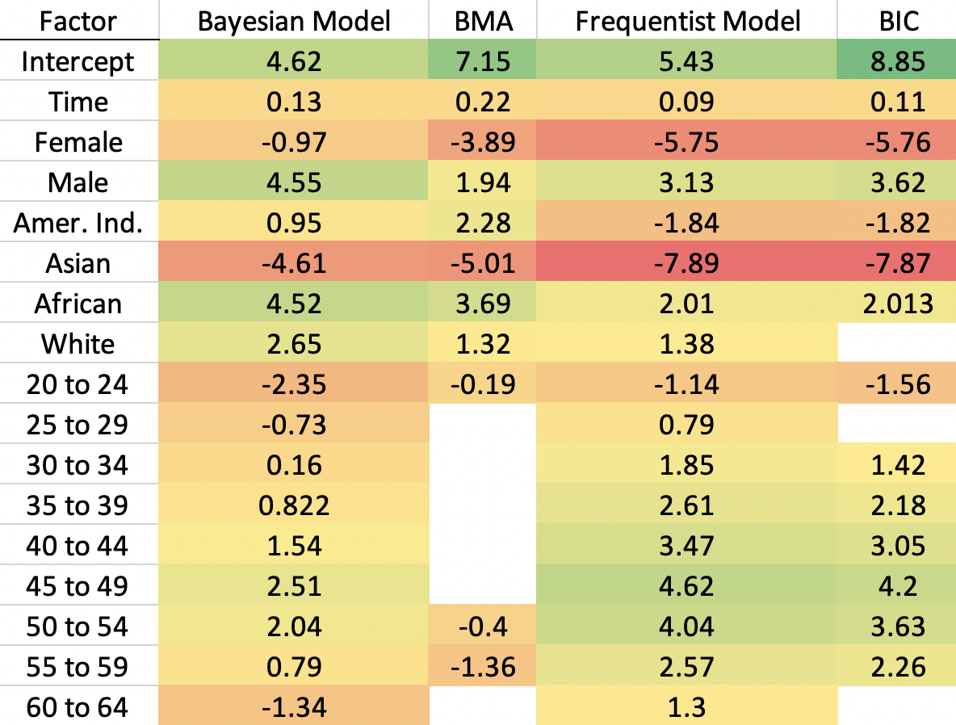
Coefficient comparison

Slide 16
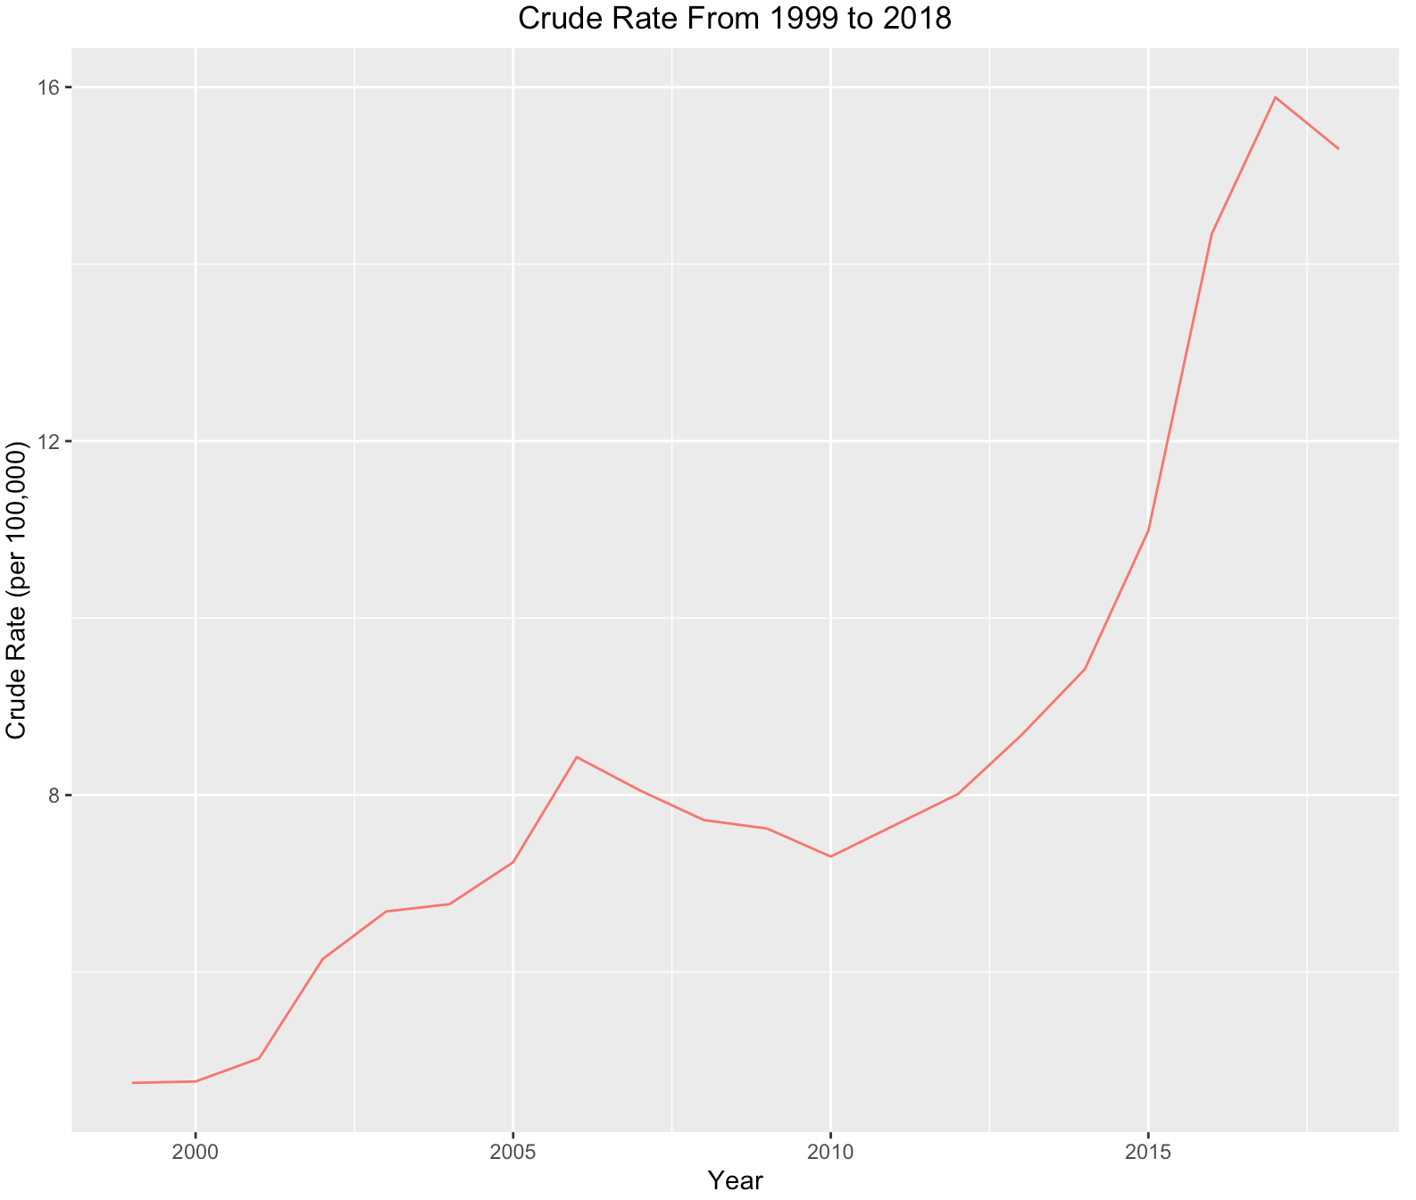
Comparison of Intervals for Validation Dataset of 2017
Bayesian model: 15 variables
BMA Bayesian model: 13 variables
Linear regression: 55 variables
LASSO regression: 26 variables
2017 true crude rate CI: (9.10, 14.83)
Bayesian CI: (8.43, 11.96)
BMA CI: (8.13, 11.22 )
Linear Regression CI: (8.02, 14.56)
LASSO CI: (7.89, 14.91)

Slide 17
Conclusion
Bayesian method provides similar variable coefficients and credible intervals while producing posterior distributions for variables
When dealing with many interactions, LASSO is a good option for decreasing dimension space
White and African-American middle-aged males are impacted the most by the opioid crisis

Slide 18
Thank you

Slide 19
